Slide 1
Scientific Machine Learning and Tensorflow tutorial
Additional topics and Reproducibility
Ravi G Patel
Scientific Machine Learning Department
February 1 – 2, 2024
Numerical PDEs: Analysis, Algorithms, and Data Challenges
ICERM
Brown University
SAND2024-00936O

Slide 2
overview
Neural ODE
Sparse regression
Attention and transformers
Physics informed constraints
Approximate Bayesian methods
Generative modeling
Optimal experimental design
Digital twins
Reproducibility

Slide 3
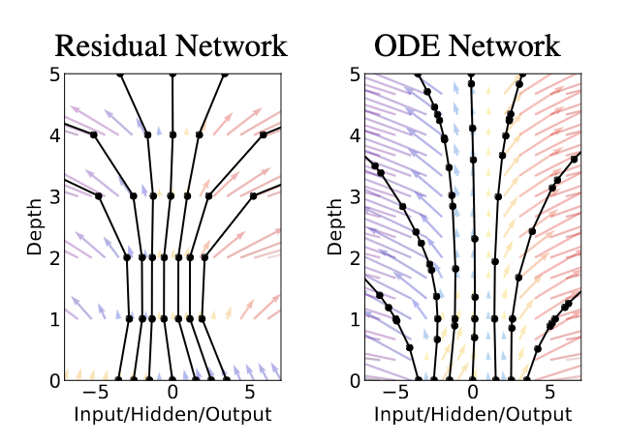
Neural ODE (NODE)¹
Limit of a neural network to infinite depth
Backprop can be derived using adjoint sensitivity²
Computation graph for a NODE
¹R. Chen et al., NeurIPS (2018)
²A. Bradley, PDE-constrained optimization and the adjoint method (2019)
Comparison between ResNet and NODE¹

Slide 4
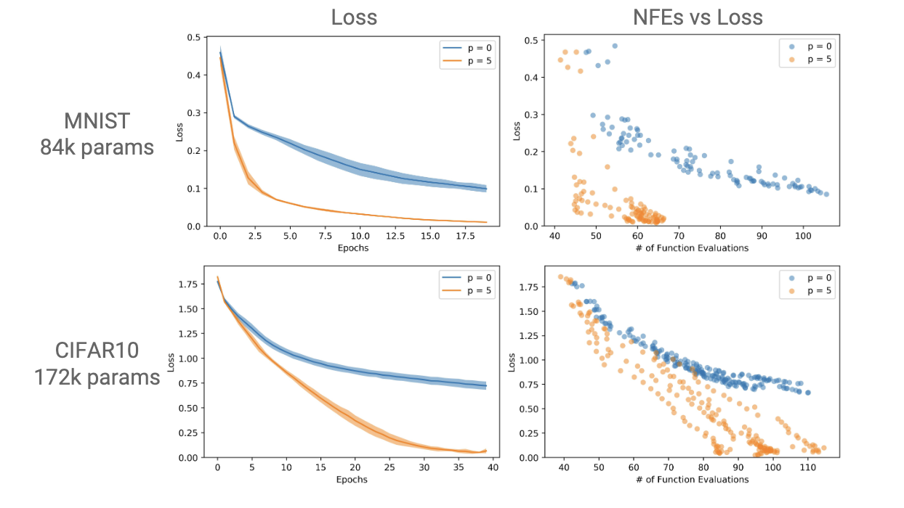
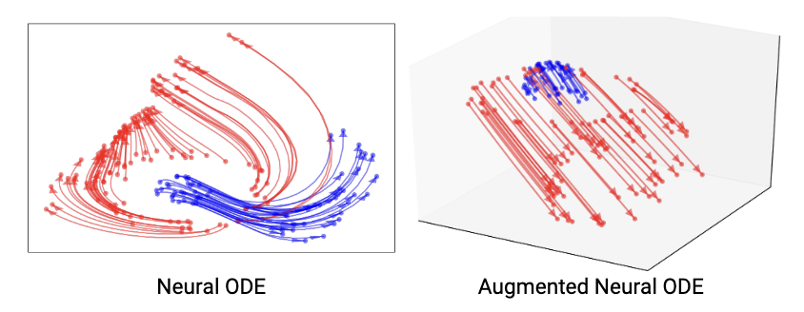
Augmented Node¹
Augmenting a NODE with auxiliary variables can simplify learned model
Learned flows for NODE and Augmented NODE¹
NODE vs. Augmented NODE for Classification¹
¹E. Dupont et al., NeurIPS (2019)

Slide 5
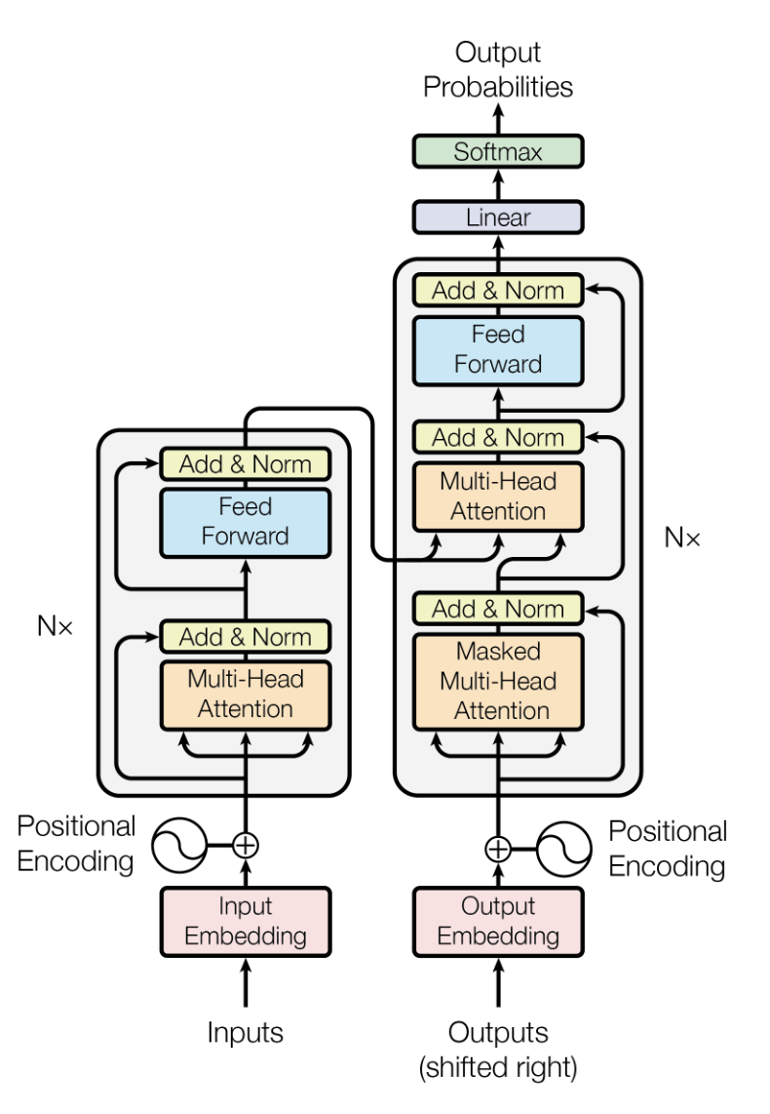
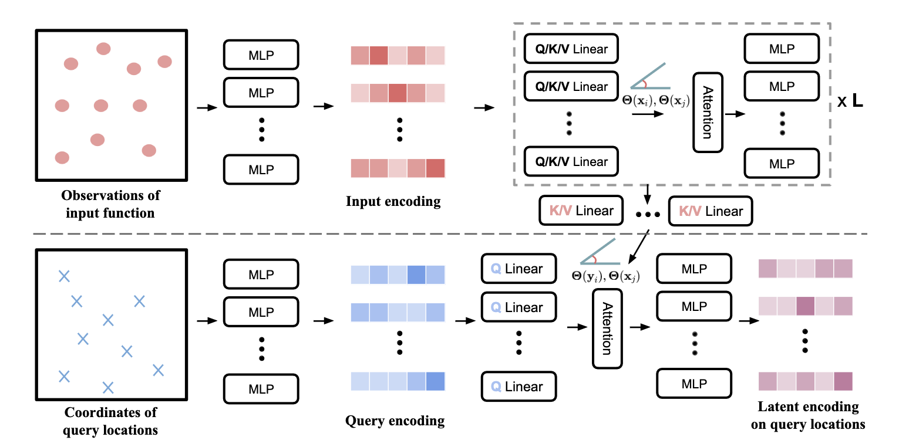
Transformers
Alternative to RNN’s
From sequences of data, correlates parts of it together. Given a new sequence of data, predicts the next piece
Original Transformer architecture for NLP Vaswani et al., NeurIPS (2017)
Transformer for Operator learning Zi et al., TMLR (2023)

Slide 6
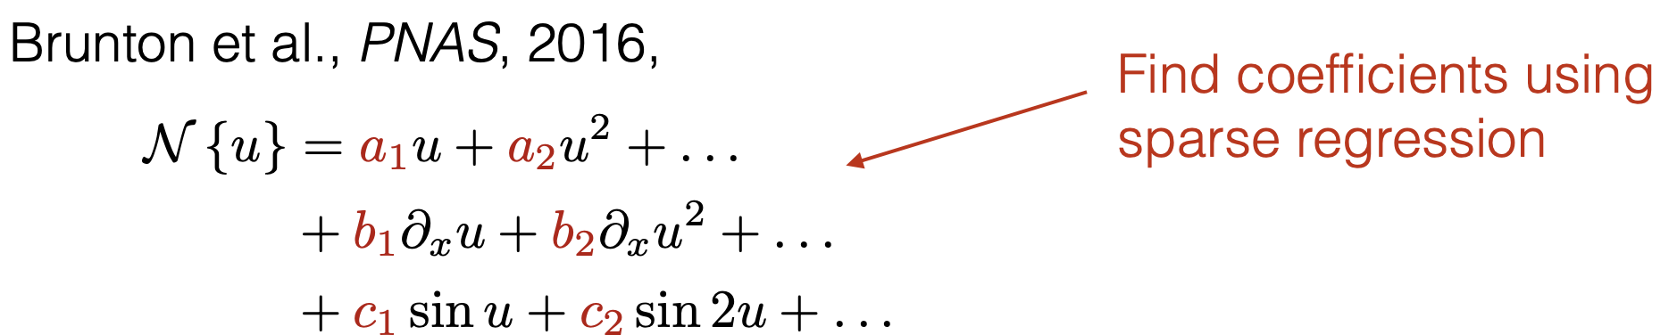
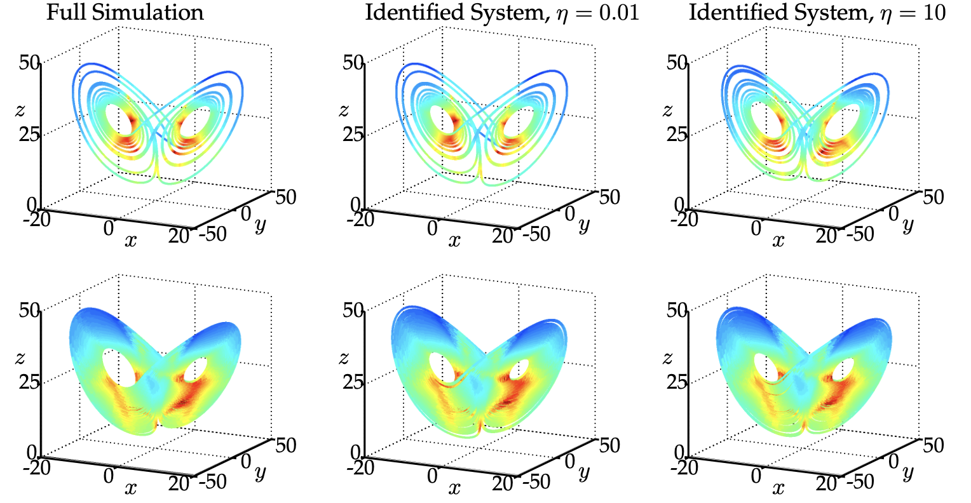
Sparse regression - Sparse identification of nonlinear dynamical systems (SINDy)
SINDy finds the Lorenz system

Slide 7
Physics informed constraints
Many SciML methods can incorporate a priori known information
Hyperbolicity preservation for learning the equations of state for Euler
Patel et al., CMAME (2021)
Entropy is a convex function of volume and internal energy
Other examples,
Conservation laws
Mass density is non-negative
Stress is positive semi-definite
Current vs. voltage is monotonic through a passive circuit component

Slide 8
Physics informed constraints - Equivariance
Often we’ll have models with equivariance,
If we have a model,
It is equivariant w.r.t. a group, , if for representations, ,
E.g., SO(3) equivariance. If we rotate the input data and push it through the model, we’ll get the same answer as we would if we left the input alone, but rotated the output
SO(3) is a subgroup of the Galilean group
Frame indifference in mechanics

Slide 9

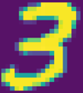

Equivariance in image classification
Translation, scaling, and rotation shouldn’t affect an image’s class
Data augmentation: train with transformed versions of training data
How thoroughly should transformations be sampled?
Increased cost of training
Choose model form to have desired invariance/equivariance
E.g. ConvNets for approximate translational invariance¹
¹ Lawrence et al. IEEE Transactions on Neural Networks, 1997

Slide 10
Other examples of Equivariant models
Rotation invariant model for galaxy classification
Dieleman et al. Monthly Notices of the Royal Astronomical Society, 2015
Warp invariant model
Wong et al. DICTA, 2016
Permutation invariant model
Meltzer et al. arXiv:1905.03046
Rotation and translation equivariant model for 3d point cloud data
Thomas et al. arXiv:1802.08219

Slide 11
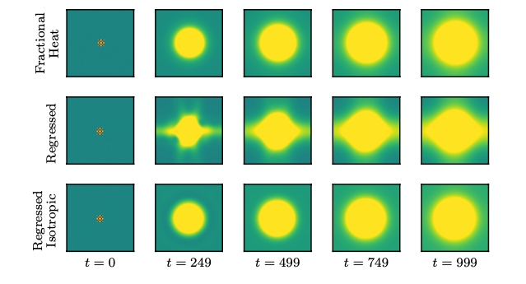
Physics informed constraints for Operator learning^{1,2}
We can enforce constraints in MOR-Physics by modifying the parameterization,
Translational equivariance:
apply point-wise,
Reflective symmetry:
if solves the PDE, so does
let
Rotational equivariance:
let
Global conservation:
let
Preserving rotational equivariance leads to better extrapolation
¹R.G. Patel and Desjardins, arxiv: 1810.08552 (2018)
²R.G. Patel et al., CMAME (2021)

Slide 12
Approximate Bayesian methods
Rarely, do we have conjugacy in Bayesian inference
E.g., the nonlinearity in neural networks
But if we have
We can still approximately get the posterior
Markov Chain Monte Carlo (MCMC)
Evolve a Markov Chain with stationary distribution converging to the posterior
S. Sahu, http://www.southampton.ac.uk/~sks/utrecht/mcmc.pdf (2000)
Variational inference (VI)
Introduce a parameterized (variational) distribution. Minimize the divergence between it and the posterior
D.M. Blei, JASA (2017)
Both methods are available in tensorflow_probability

Slide 13
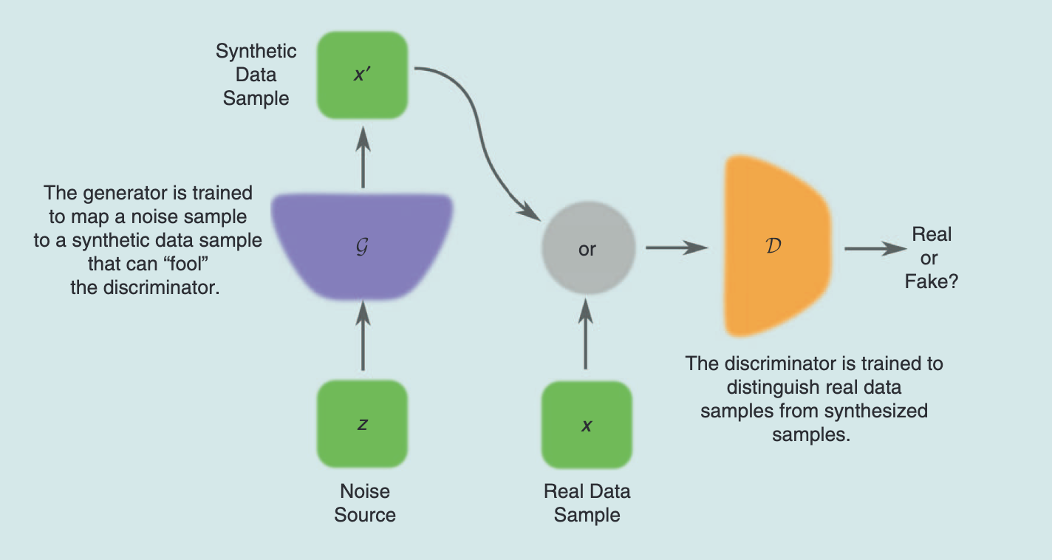
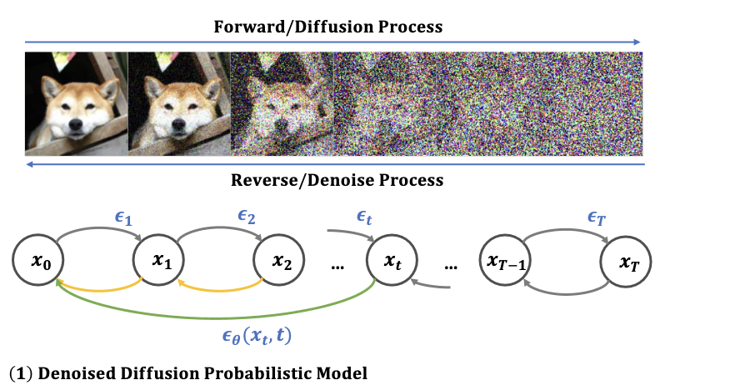
Generative modeling
Often, we just want samples of a distribution and don’t want to model posteriors
E.g.,
Generative adversarial networks A. Creswell et al., IEEE Signal Process. Mag. (2018)
Diffusion model H. Cao et al., axXiv:2209.02646 (2018)

Slide 14
Optimal experimental design
Traditionally,
Optimal experimental design (OED),
Given the data we have, where should the next experiment be performed?
Simulation
Experiments
Design
Simulation
Experiments
Design

Slide 15
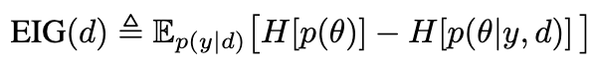
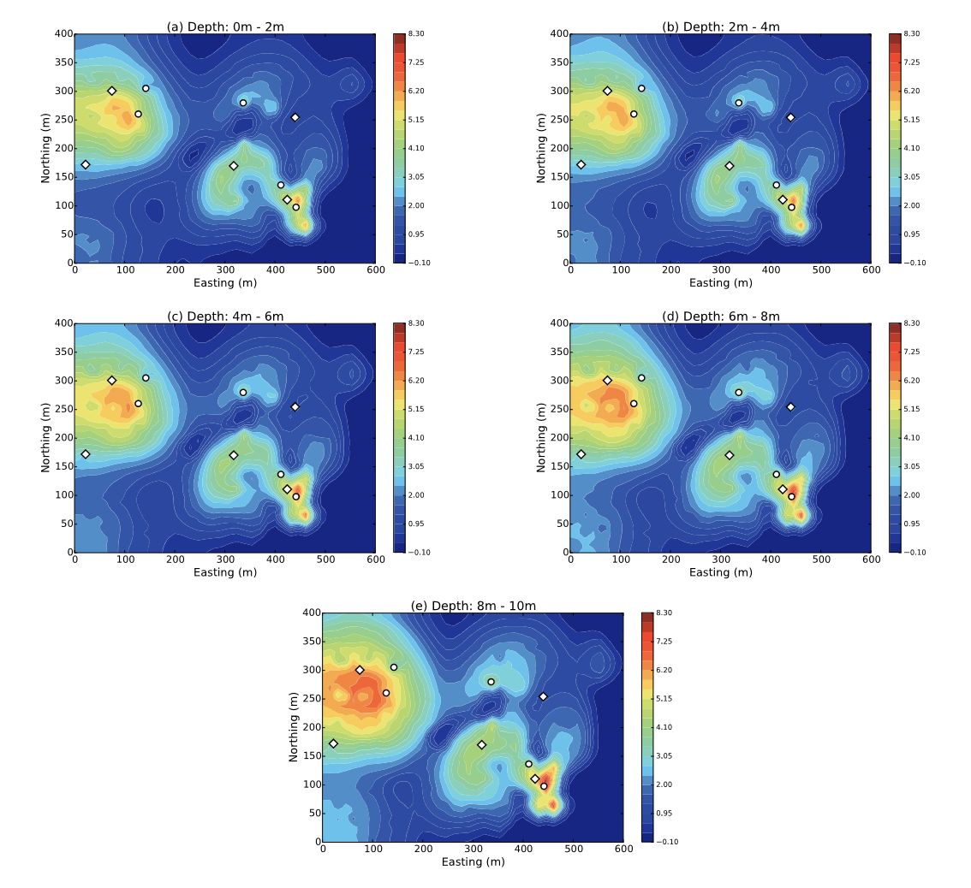
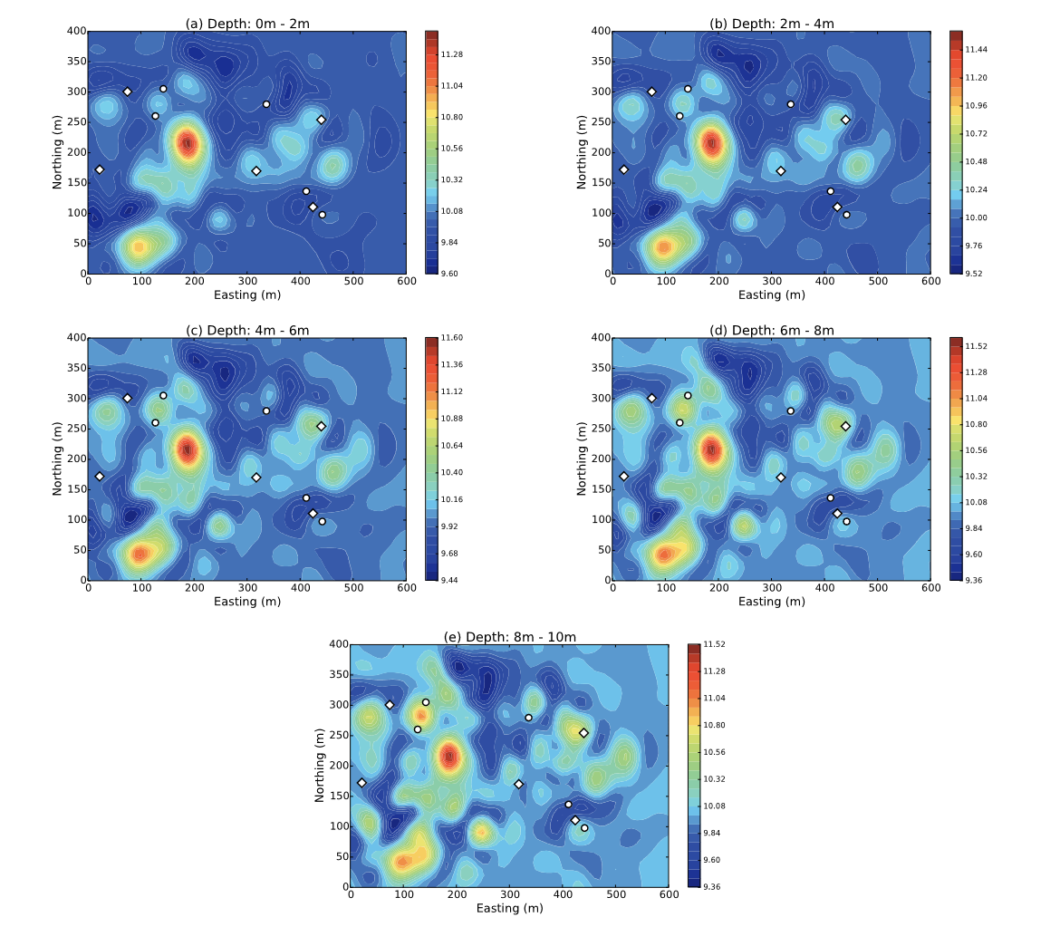
Optimal experimental design
We can optimize the next experiment against a metric
E.g., Expected information gain
OED for permeability in contaminated soils P. Tsilifis, SIAM UQ (2017)

Slide 16
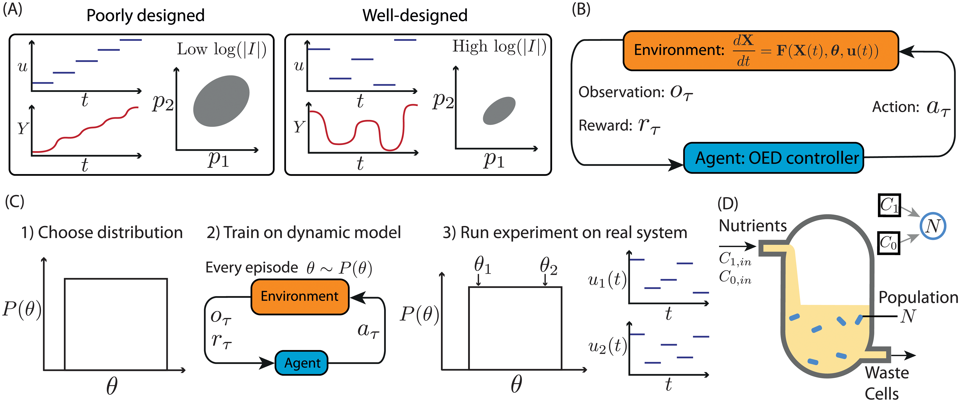
Active learning
Active learning is an iterative process
Often agent based
Reinforcement learning
Introduce actions and rewards for actions
Introduce an agent that maximizes the reward w.r.t. actions
Learn
Get new data
Reinforcement learning for OED of bacteria growth in chemostat N.J. Treloar, PLoS Comput. Biol. (2022)

Slide 17
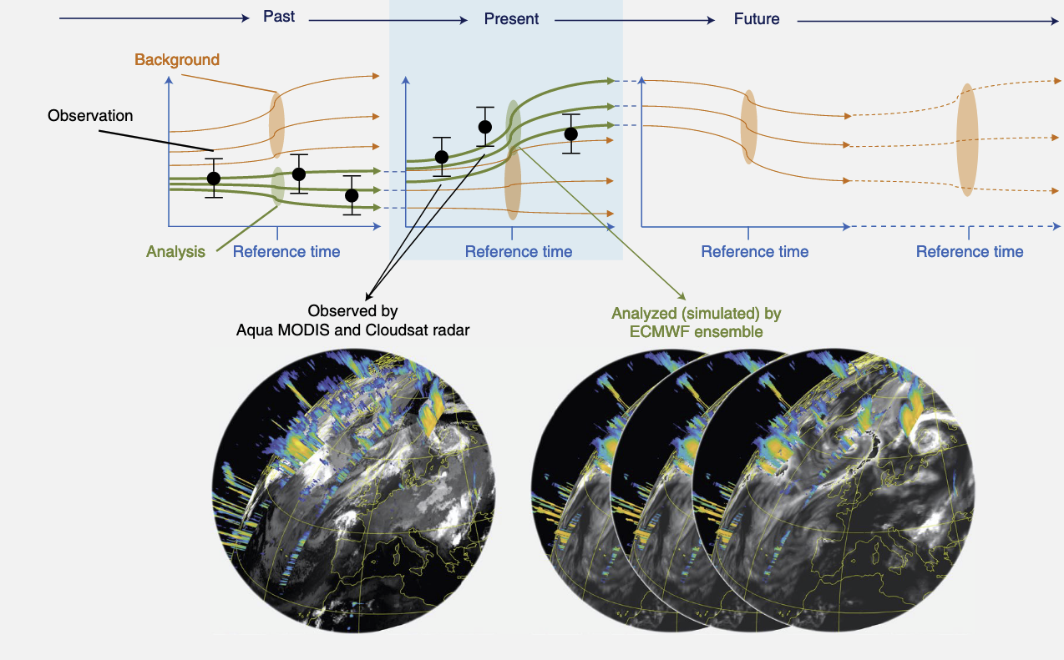
Digital twins
Combining active learning from multiple sources, we can construct digital representations of systems,
An Earth digital twin - combining MODIS and Cloudsat observations with ECMWF simulations¹

Slide 18
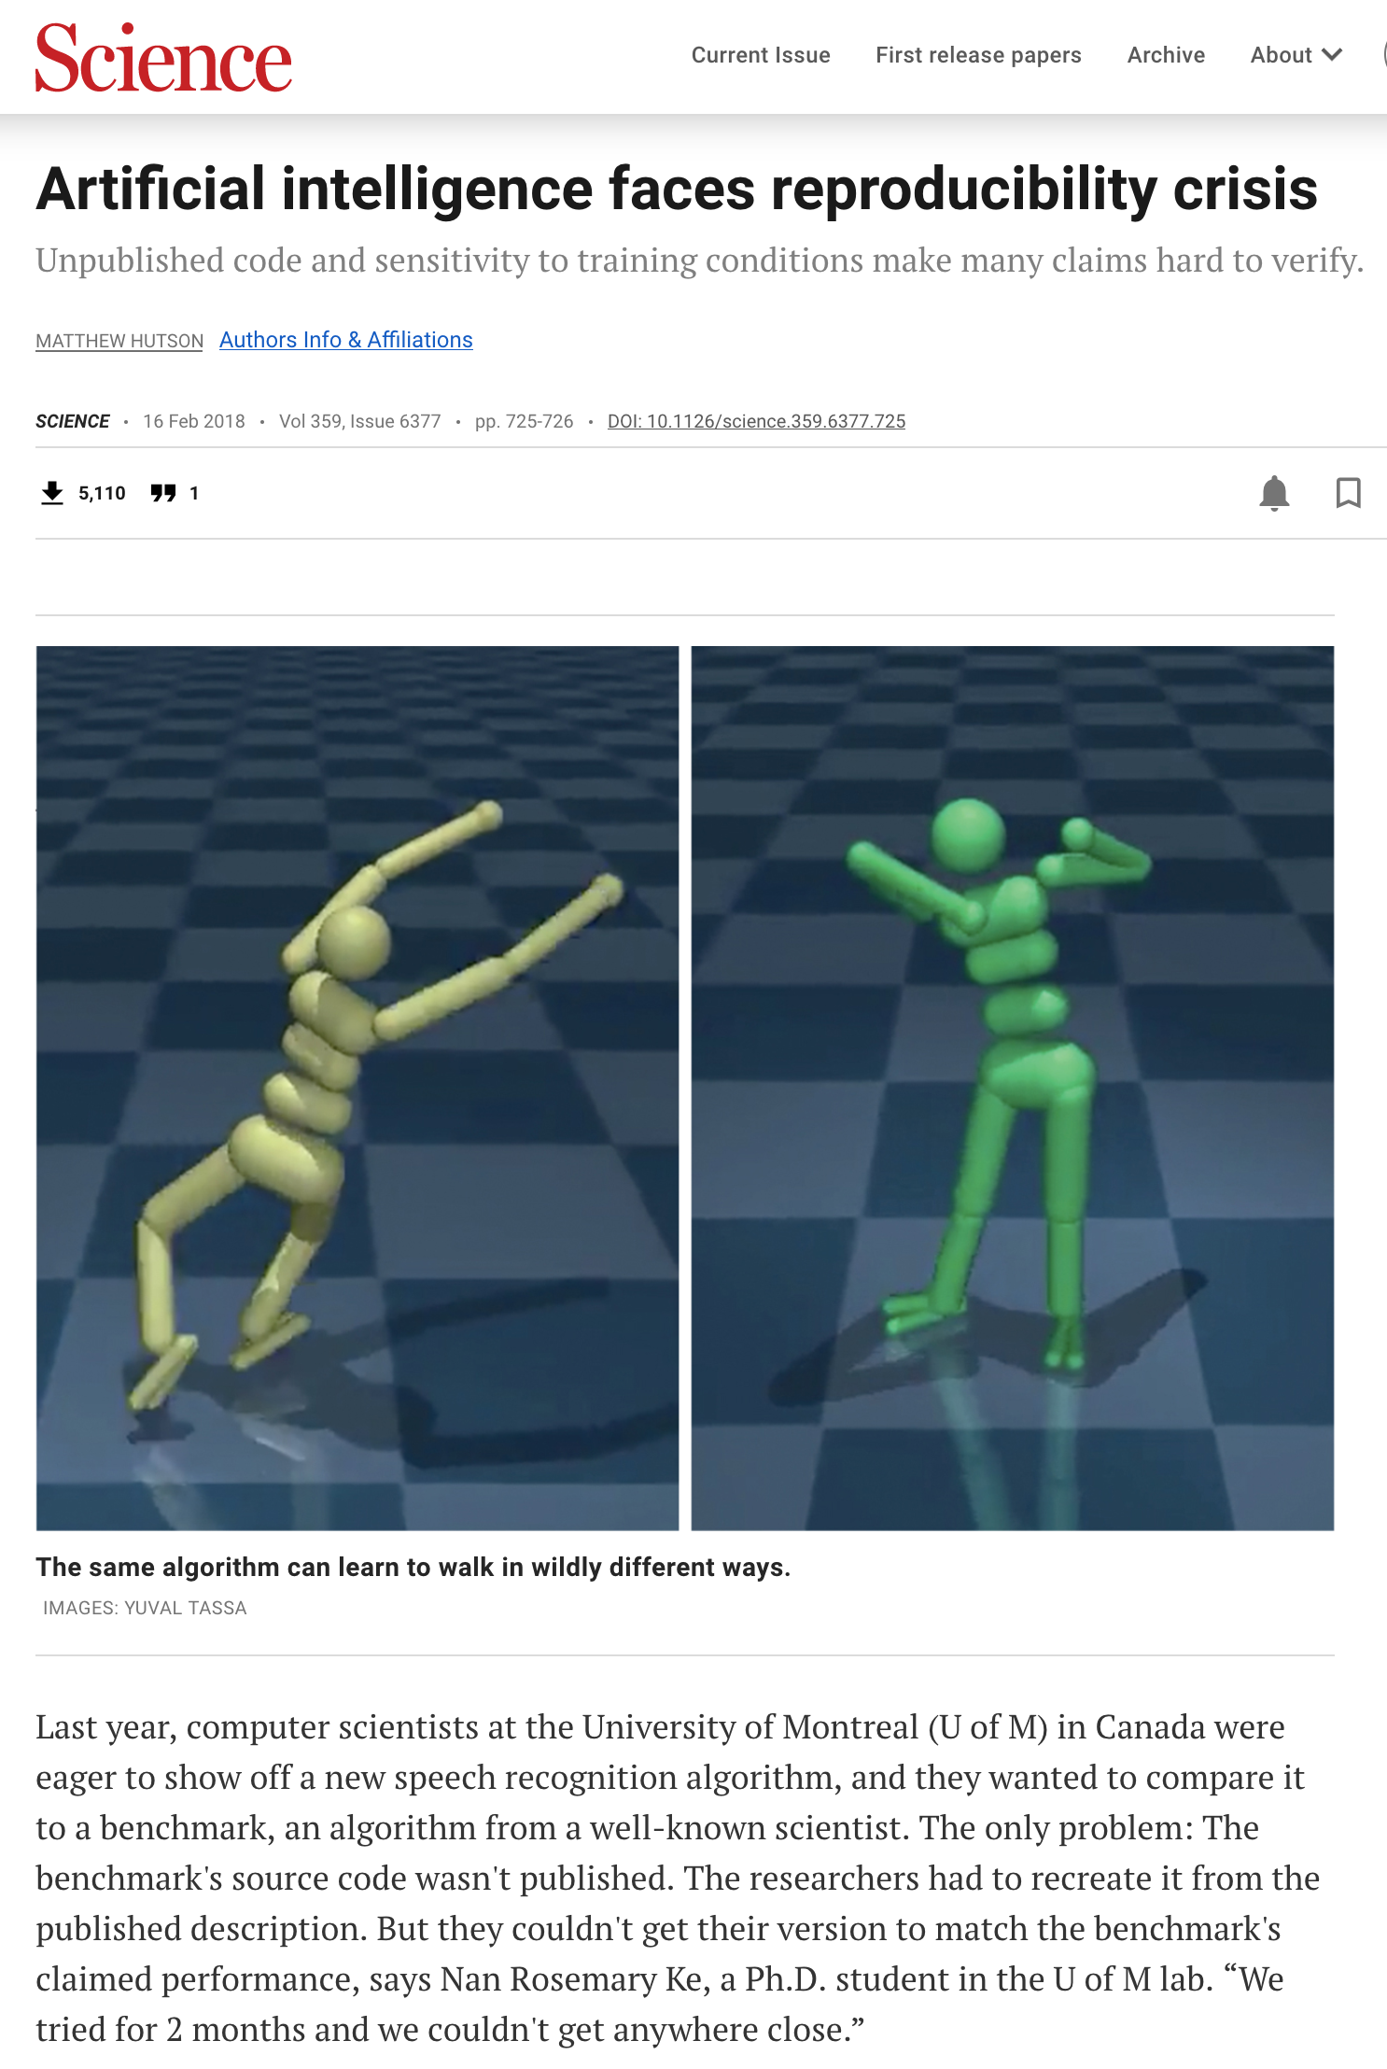
Reproducibility in Sciml
Workflows for sharing code
Users should be able to run our code and get the same results
Control for dependencies and random seeds
Containers
E.g., Docker
C. Boettiger, Oper. Syst. Rev. (ACM) (2015)
Package managers
E.g., conda
J. Shenouda et al., IEEE Signal Process. Mag. (2023)

